Slide 1

CDR Presentation:
Computerized Automatic Rapid Deck Sorter (CARDS)
Emily Gensch, Henry Abshire,
Benjamin Harris, Nicholas Heikes
Group 19

Slide 2
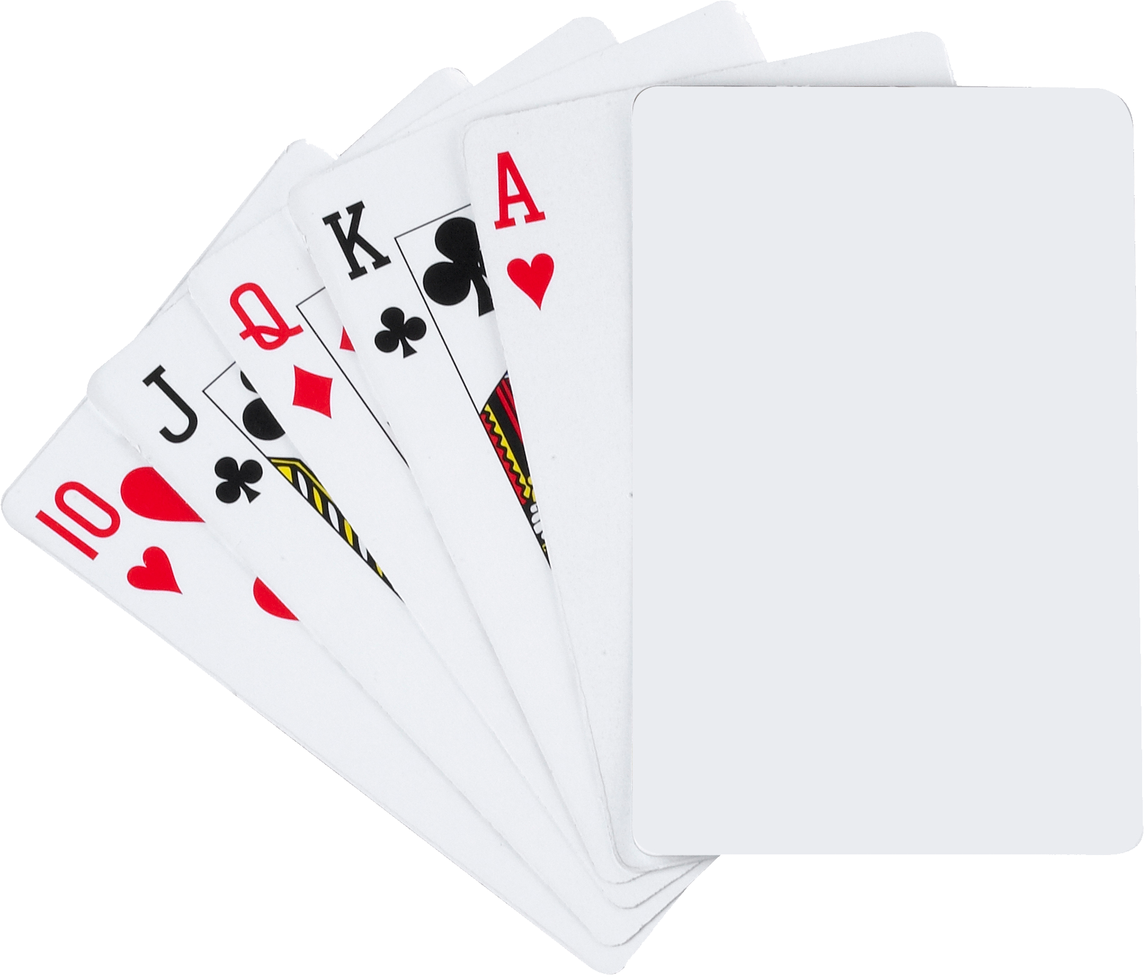
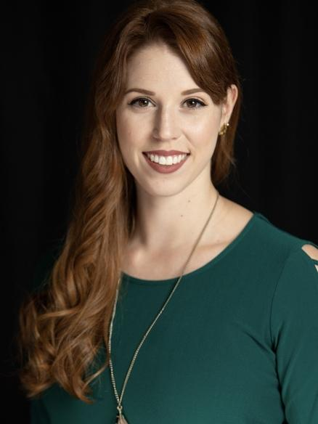



Group Members
Emily Gensch, CpE Henry Abshire, CpE Nicholas Heikes, CpE Benjamin Harris, EE
Project Manager Hardware Lead Software Lead Electrical Lead
& Mechanical Lead

Slide 3

Sorting Machine
Our automated card sorting system will demonstrate the core functionality needed for next-generation currency processing. The machine will accept playing cards inserted in any orientation—face up, face down, or rotated—and automatically detect, orient, and sort them into organized stacks. Using sensors and mechanical components, it will identify card positioning, correct alignment issues in real-time, and efficiently organize cards without human intervention. This proof of concept will validate the technology's ability to handle the variable conditions and orientations that banking machines currently struggle with, paving the way for currency processors that can accept bills in any configuration while maintaining speed and accuracy.
What is our project?

Slide 4
Motivation
Current Problem: Banks require bills to be manually oriented before processing
Tellers spend significant time aligning currency deposits
ATMs force customers to pre-orient bills before insertion
Results in longer wait times and customer frustration
Inefficiency Impact:
Increased operational costs for banks
Reduced customer satisfaction during busy periods
Potential for human error in manual sorting processes
Market Need: Use playing cards as a proof of concept to develop automated sorting technology that will eventually handle currency in any orientation

Slide 5
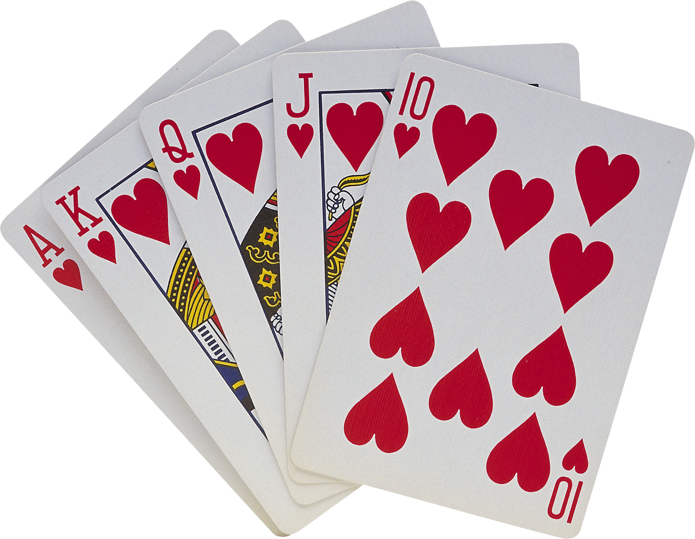
Why Playing Cards?
Similar Properties: Paper-based construction and rectangular shape mirror actual currency
Improved Handling: Smaller size and better grip reduce mechanical issues during development
Cost-Effective: Allows extensive testing without security protocols required for real money
Safe Development: No regulatory complications during prototype phase

Slide 6
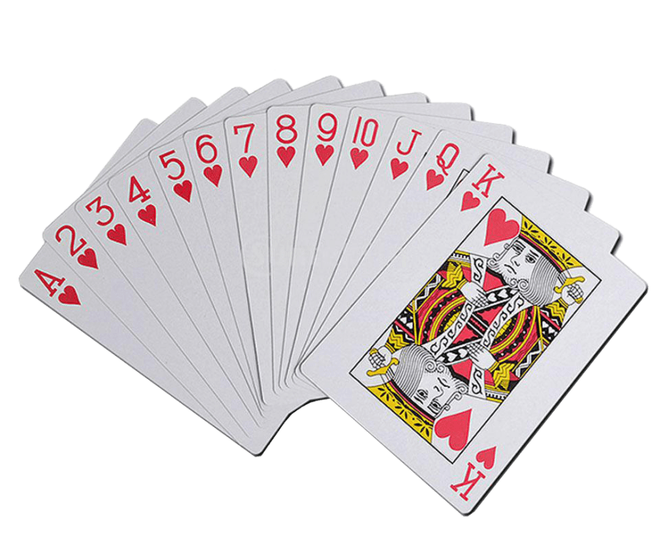
Objectives and Goals
Goals:
1. Optimal Detection Mechanism: Determine the optimal mechanism to detect and adjust card orientation, including sensor types and actuator designs
2. Jam Prevention Design: Design the machine to minimize jams or errors, considering factors such as card thickness, material, and size variations
3. User-Friendly Interface: Develop a user-friendly interface and system alerts to notify operators of errors, maintenance needs, or completed operations
4. Performance Testing: Test the machine's efficiency and reliability under various conditions, including mixed card states, to ensure robust performance
Objectives:
1. Automatic Orientation & Alignment: The machine will be capable of orienting and aligning playing cards to ensure uniform direction and orientation, regardless of their initial state
2. Neat Output Stacking: The machine must output cards in a neatly stacked format, ready for further handling or storage
3. Minimal User Intervention: The machine will operate with minimal user intervention, featuring an intuitive interface for setup and monitoring

Slide 7
Engineering Specifications
Specification | Description | Target
Power Consumption | The maximum power draw of the device at full load. | Less than 60 watts.
Throughput | The minimum number of bills the device can dispense per second after the first bill reaches the output. | At least 2 bills/second.
Sorting Accuracy | The minimum average percentage of bills that are correctly sorted at the output per input stack. | At least 98%.
Error Detection Rate | The minimum rate at which the device detects multiple bills being drawn into the system simultaneously. | At least 90%
Capacity | The minimum capacity of bills that can fit into the entry box. | At least 50 bills.
Maximum Weight | The maximum weight of the finished device. | Less than 5 kilograms.
Bill Detection Accuracy | Rate at which the system's sensors accurately detects the bill at the point of input. | At least 98%.
Operating Temperature | The acceptable operating temperature range of the device during use. | 0 ℃ - 55 ℃.
Unit Manufacturing Cost | The maximum cost to manufacture a single functional unit of the device. | Less than $100 USD.
Color Processing Time | The minimum time at which the bill’s color is detected and identified. | Less than 100 milliseconds

Slide 8
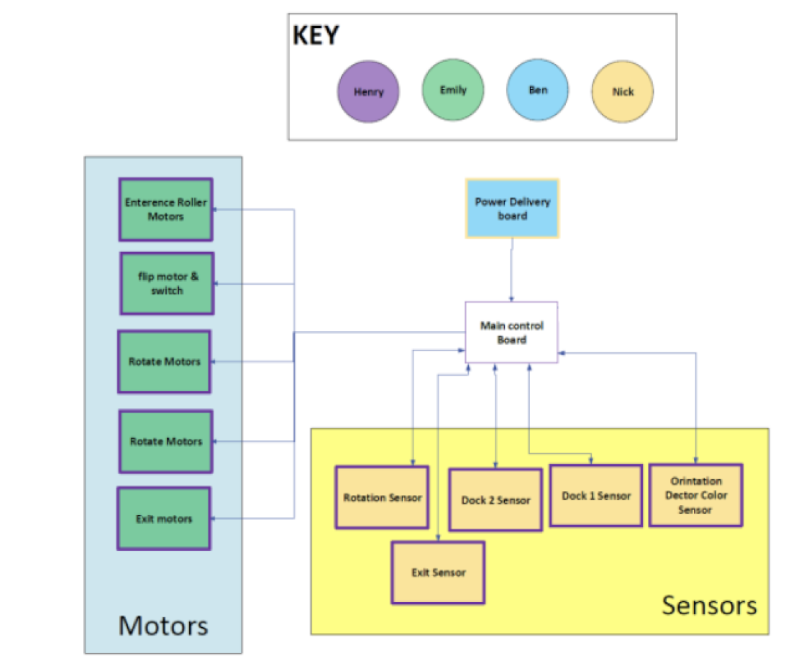
Hardware Block Diagram

Slide 9
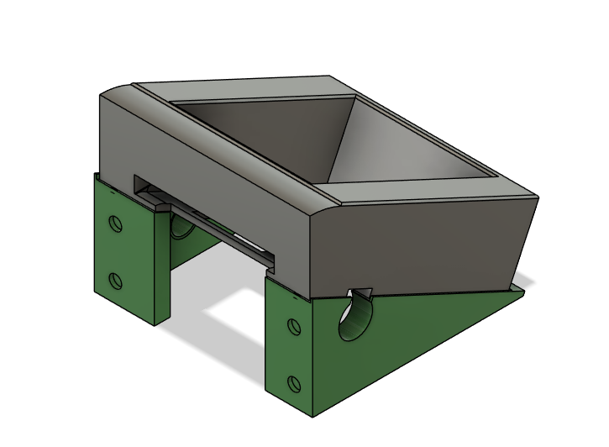
Entry Box
The machine is equipped with a specially designed input tray that allows users to load a stack of cards effortlessly. Once placed into the tray, the machine’s precision feeding system uses servo motors to carefully pick up each card one at a time, guiding it smoothly into the internal processing system for analysis. This ensures a steady and controlled intake, preventing jams or misfeeds.

Slide 10
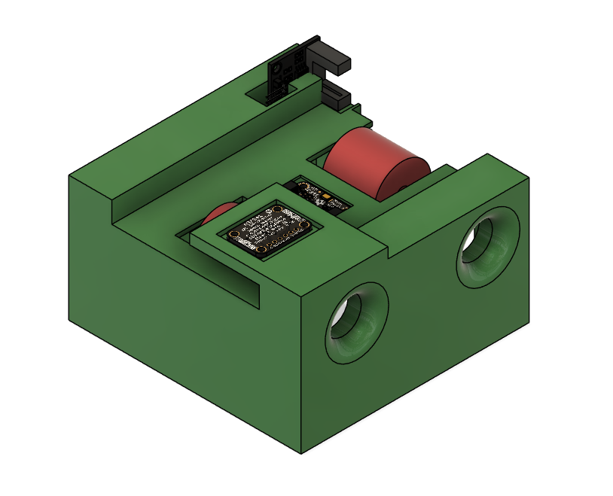
Color Scanning Station
As each card moves through the machine on the backs of servo motors, it passes through an advanced scanning system that carefully inspects its features. This scanner plays a crucial role in identifying the card’s orientation. By utilizing high-speed optical scanning technology, the system ensures that each card is processed with accuracy and efficiency.

Slide 11
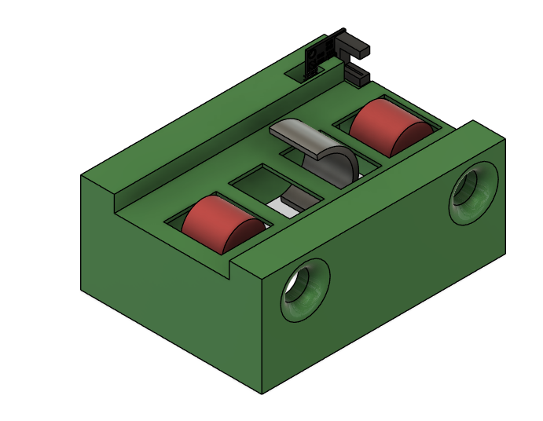
Flipper station
If the scanning system detects that a card is facing the wrong side up, the machine’s intelligent flipping mechanism is activated. This automated feature precisely rotates the card to its correct position using servo motors before moving it forward for further processing. By eliminating the need for manual adjustments, this mechanism contributes to the overall efficiency and reliability of the machine.

Slide 12
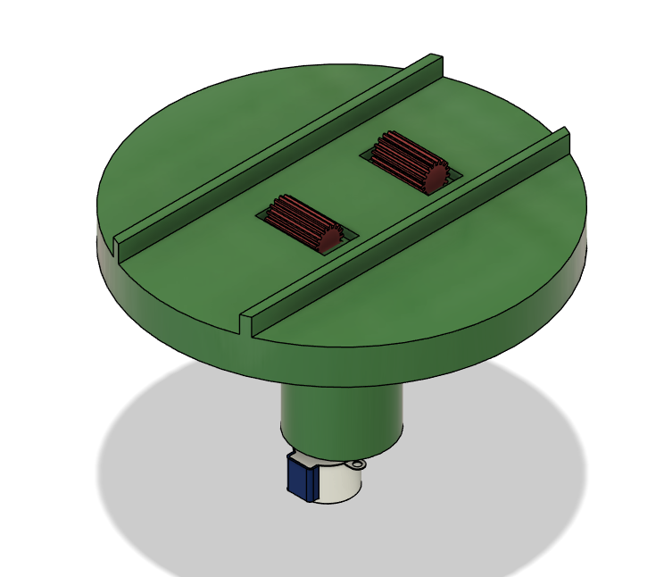
Rotation Station
To maintain uniformity in the final output, the machine is equipped with a sophisticated orientation system. This mechanism ensures that each card exits the machine in a perfectly aligned manner, with a consistent top-to-bottom and front-to-back configuration. The station is operated by a single stepper motor connected to the base of the station Regardless of how the cards are inserted into the machine initially, they are processed and adjusted so that they emerge in an organized and standardized format.

Slide 13
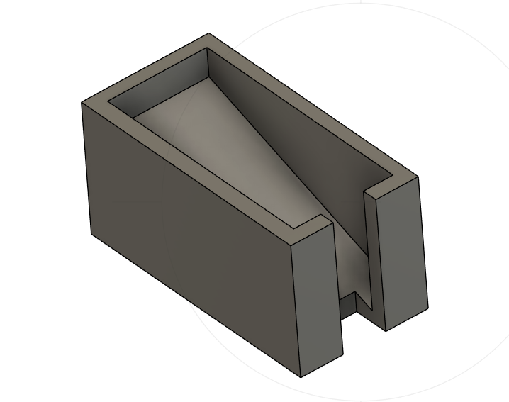
Exit Box
Once the cards have been fully processed, they are neatly delivered to one of the output trays in a uniform and well-organized stack. This feature allows for easy retrieval and handling, ensuring that the processed cards remain neatly arranged and ready for use. The output mechanism minimizes the need for manual sorting, reducing time and effort for the user.

Slide 14
AC VS DC motors
Motor Type | AC | DC
Durability | 5-10 years | 1000-3000 hours
Driver method | Requires Alternator | Direct voltage
Response time | 0.5-1 seconds | 0.1-0.5 Seconds
Speed regulation | 1:300 | 1:1000
Start up Current requirement | 5-7x operating current | 2-3x operating current
Sound | Loud | Quiet
Notes:
3phase-motor (2025) Which is better, DC or AC Motor, Ligong Motor. Available at: https://www.3phase-motor.com/post/which-is-better-dc-or-ac-motor/ (Accessed: 19 June 2025).

Slide 15
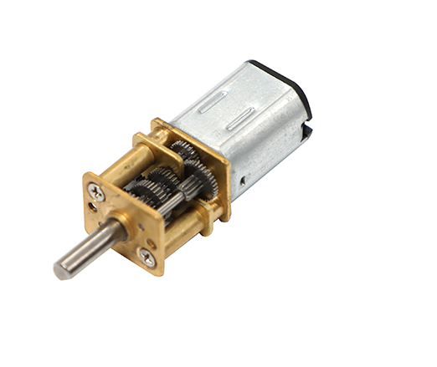
G12-N20 Geared Mini DC Motor
 | G12-N20 Geared Mini DC Motor | M260 | Adafruit DC Toy / Hobby Motor - 130 Size
Voltage (V) | 3 - 12 V | 1-3 | 4.5-9
Current | 70 mA - 1 A | 110 mA - ：800 mA | 70 mA -500 mA
Power Consumption | 42 mW - 12 W | 0.11 - 0.33 W | 0.42 W
Speed (RPM) | 50 - 200 RPM | 6600 ±10% | 9100 ±1800 rpm
Torque (Nm) | 2 - 16 kg*cm | N/A | 20 g*cm
Size | 36 x 12 x 10mm | 11.9 x 15.3 mm | 27.5mm x 20mm x 15mm
Weight | 10g | 26g | 17.5g
Shaft size | 3 x 10mm | 6 mm and 10 teeth gear | 8mm x 2mm diameter
Cost | $1.68-$15.00 | $2.10 | $2.00
Temp Range | 0-70℃ | -5℃- 40℃ | -

Slide 16
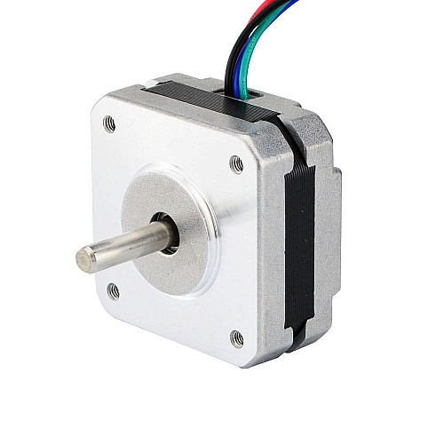
Stepper Online 17HS08-1004S -Stepper motor
 | StepperOnline 17HS08-1004S | StepperOnline 17HS13-0404S1 | Adafruit XY42STH34-0354A
Voltage (V) | 3.7 | 12 | 12
Current/Phase (mA) | 1000 | 400 | 350
Power Consumption/Phase (W) | 3.7 | 4.8 | 4.2 W
Torque (N-cm) | 16 | 26 | 15.7
Step Angle (Degrees) | 1.8 | 1.8 | 1.8
Size (mm) | 42 x 42 x 20 | 42 x 42 x 34 | 42 x 42 x 34
Weight (g) | 140 | 230 | 220
Cost (USD) | $7.99 | $12.50 | $14.00

Slide 17
DRV8912-Q1 – 12 Channel Brushed DC Motor Driver
 | DRV89XX-Q1 | L9110S | L298P
Number of Half Bridge | 4,6,8,10, and 12 | 1 | 2
Input Voltage (chip) (V) | 0-5.5V (norm 3.3-V and 5-V) | 2.5-12 6 (TYP) | 4.5 - 7 5 (TYP)
Output Voltage (V) | 4.5 - 32V (requires input of same value) | 0-Vcc | 4.8 - 50
Output Current (A) | 6 | .800 | 3 (non constant) 2 (constant)
Power Rating (W) | 27-280 | 2-9.6 | 25
Supported Motor Types | brushed-DC (BDC) motors or stepper motors | Steeper & DC | brushed-DC (BDC) motors or stepper motors
MISC Protection | nFAULT, OLD, (OTW/OTSD) | No | Over temp protection
Control Method | PWM | PWM | PWM
Communication Protocol | SPI | Binary | binary
Libraries | Arduino (open source) | Arduino (open source) | Arduino
Speed Range | 80-2000HZ (PWM) | N/A | N/A
Over Voltage/Current Protection | Yes | No | Yes through sense pins
Dimensions | 7.80 mm × 4.40 mm | 6mm x 5mm x 3.2mm | 16 x 11.1 mm
Temperature Range (°C) | -40 to 125 | -30-85 | –25 to 130
Cost | $1.05-1.56 (TI) $2.78-5.33 (digit key) | $0.98 | $1-12.00

Slide 18
DRV8825 – Stepper Motor Driver
 | DRV8825 | DRV8912
Input Voltage | 8.2V - 45V | 0-5.5V (norm 3.3-V and 5-V)
Max Output Current | 2.5 A/phase (with heatsink) | 6
Control Method | STEP/DIR interface with microstepping indexer | PWM
Max STEP Input Rate | 250kHz | 500kHz
Overcurrent Protection | Yes- hardware-triggered shutdown at ~3 A | Yes
Physical Dimensions | 9.7 mm 6.4mm x 1.2mm (HTSSOP-28 package) | 7.80 mm × 4.40 mm
Operating Temp Range | -40 C to 85 C | 40 C to 85 C
Cost | $4 - 6.00 | $1.05-1.56

Slide 19
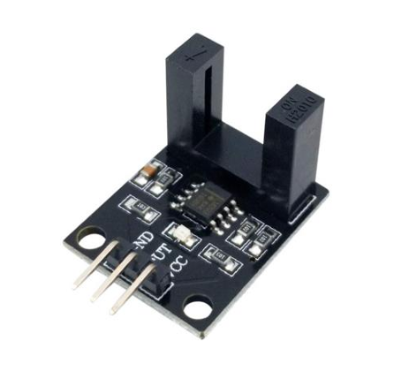
H2010 & LM393 -IR Sensor
 | TLV493D Magnetic sensor | H2010 & LM393 | IR Break Beam Sensors with Premium Wire Header Ends - 3mm LEDs
Physical dimensions | 2.9mmx2.5mm | 27x20x17mm | 20mm x 10mm x 8mm
Voltage range | 2.8 -3.5v | 3.3 -5V | 3.3-5.5 V
Current draw | 3.7 mA | 15mA | 10-20mA for Emitter 100mA sink for receiver
Sleep/standby power consumption | 7nA | 15mA | N/A
Detection range (mm/cm) | N/A | 10.3mm | 25cm
Resolution | 98 μT (resolution) | N/A | N/A
Time to detect an object | 10Hz - 3.3 KHz (update rate) | 15 μS | <2ms
Cost | $0.81 | $1.60 per unit 8 for pack of 5 | $2.95

Slide 20
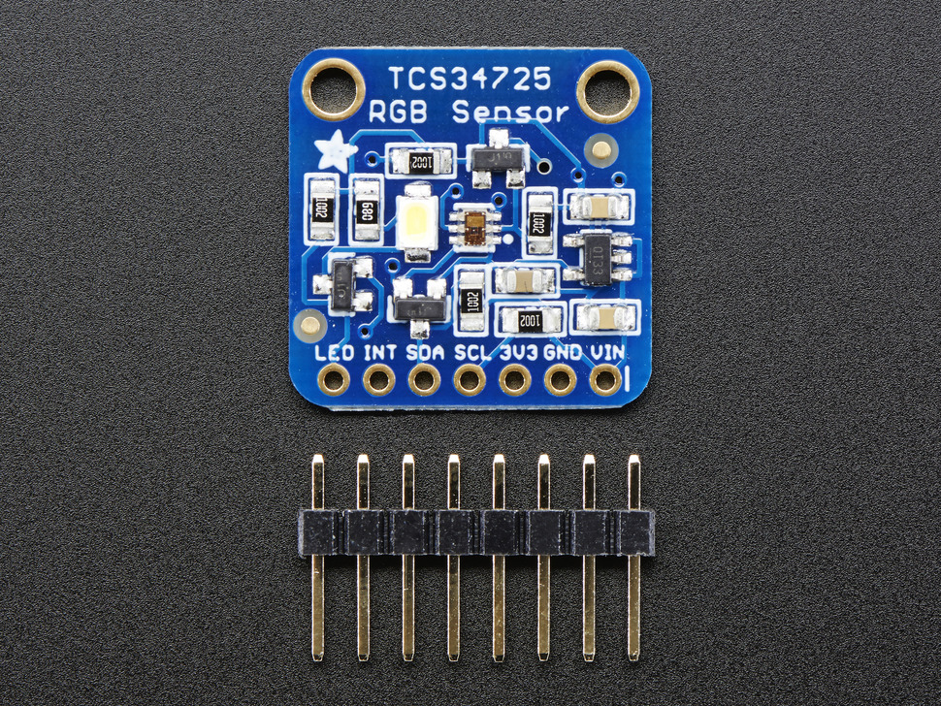
TCS34725 -Ada fruit Color Sensor
 | TCS34725 | AS7341 | TCS230
Price (USD) | 2.09 - 3.33 | 15.95 | 7.90 - 78.50
Resolution | 4 16-bits channel | 11 16-bit Channels | analog
IR filter | Yes | Yes | No
Dynamic range | 3,800,000:1 | N/A | N/A
Operating voltage | 2.7-3.8V | 1.7-2.0V | 2.7-5.5V
Current use | 2.5 (wait) – 330 (active) μA | 0.7-300 μA | 5μA
Communication interface | I2C (400 kbits/s) | I2C (400 kHz) | analog
Response Time | 2.4 - 614 ms | 27.8ms -738.8ms | 100ns
Foot print | 2mm x 2.4 mm | 6.35mm x 6.35mm x 1mm | 1.15 mm by 1.15 mm.
Interrupts | Yes | Yes | No
Color Channel | RGBC | RGBC & NIR & Flicker | RGBC
Ambient Light Sensor | Yes | Yes | No

Slide 21
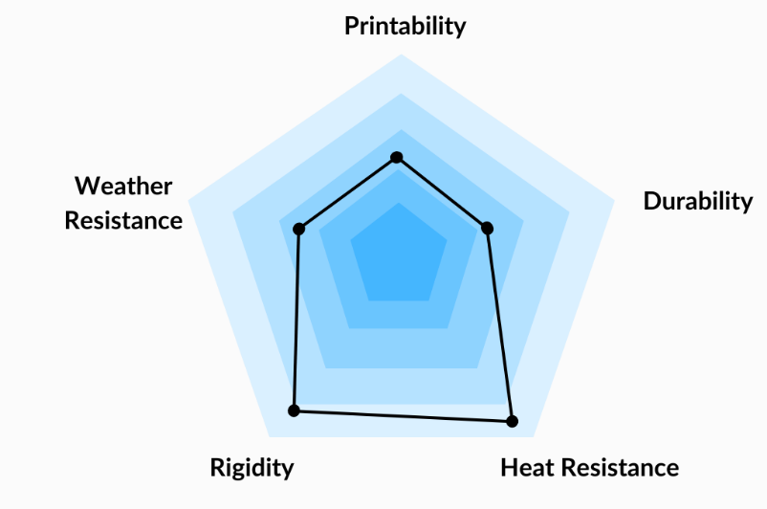
ABS - Body Material
 | PLA | PETG | ABS | TPU
Environmental Impact | Low | Mid | High | High
Tensile Strength | 37 Mpa, | 50-75 MPA | 29.8 - 60 MPa | 26.0 MPa
Elongation | 6% | 15% | 10 - 50 % | 55.0 %
Flexural Modulus | 4 GPa | 2.2-2.8 GPa | 1.6 - 2.4 GPa | 78.7 MPa
Weight | 1.3 g/cm³ | 1.29-1.4 g/cm³ | ~1.11 g/cm³ | 1.22 g/cm³
Ease of Machining / Cutting | High | mid | low | Low
Water absorbtion | 0.5-0.8 % | 0.1-0.3 % | 0.3% | 1.4%
Glass transition Temperature (degrees C) | 60 | 70-78 | 105 | -30
Cost & Availability | $6.11-15.00 | $7-20 | $10-25 | $13-25
Lifespan | ~2 Years | ~2 Years | ~50 years | 2-5 years
Melting point (Degrees C) | 160-220 | 180-230 | 200-250 | 190-250

Slide 22
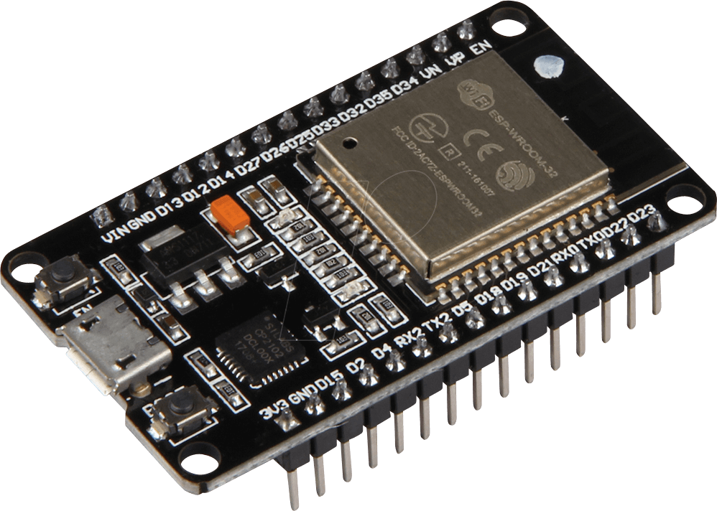
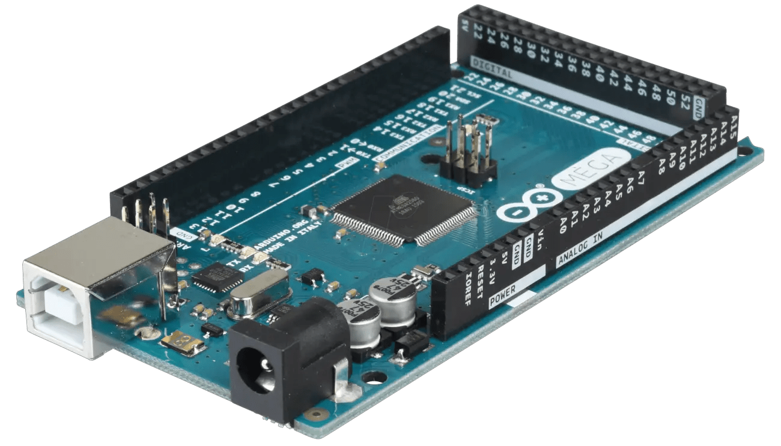
Microcontroller ESP32
Feature | ESP 32 | Arduino Mega | Teensy 4.0 | MSP430G2553 | SAMD21 | BeagleBone Black
Processor | Dual-core Xtensa LX6 | ATmega2560 | ARM Cortex-M7 | MSP430 | ARM Cortex-M0+ | AM3358 ARM Cortex-A8
Speed | 240 MHz | 16 MHz | 600 MHz | 16 MHz | 48 MHz | 1 GHz
Flash Memory | 4 Mb | 256 KB | 2 MB | 16 KB | 256 KB | 4GB
RAM | 520 KB | 8 KB | 1 MB | 512 B | 32 KB | 512 MB
Digital I/O Pins | 30 | 54 | 40 | 14 | 26 | 65
Analog Input | 18 (12 Bit) | 16 (10-bit) | 14 (12-bit) | 8 (10-bit) | 14 (12-bit) | 7 (12-bit)
PWM Channels | 16 | 15 | 35 | 8 | 12 | 8
Operating Voltage | 3.3V | 5V | 3.3V | 1.8-3.6V | 3.3V | 5V
Price (USD) | $7 | $35 | $20 | $3 | $10 | $55

Slide 23
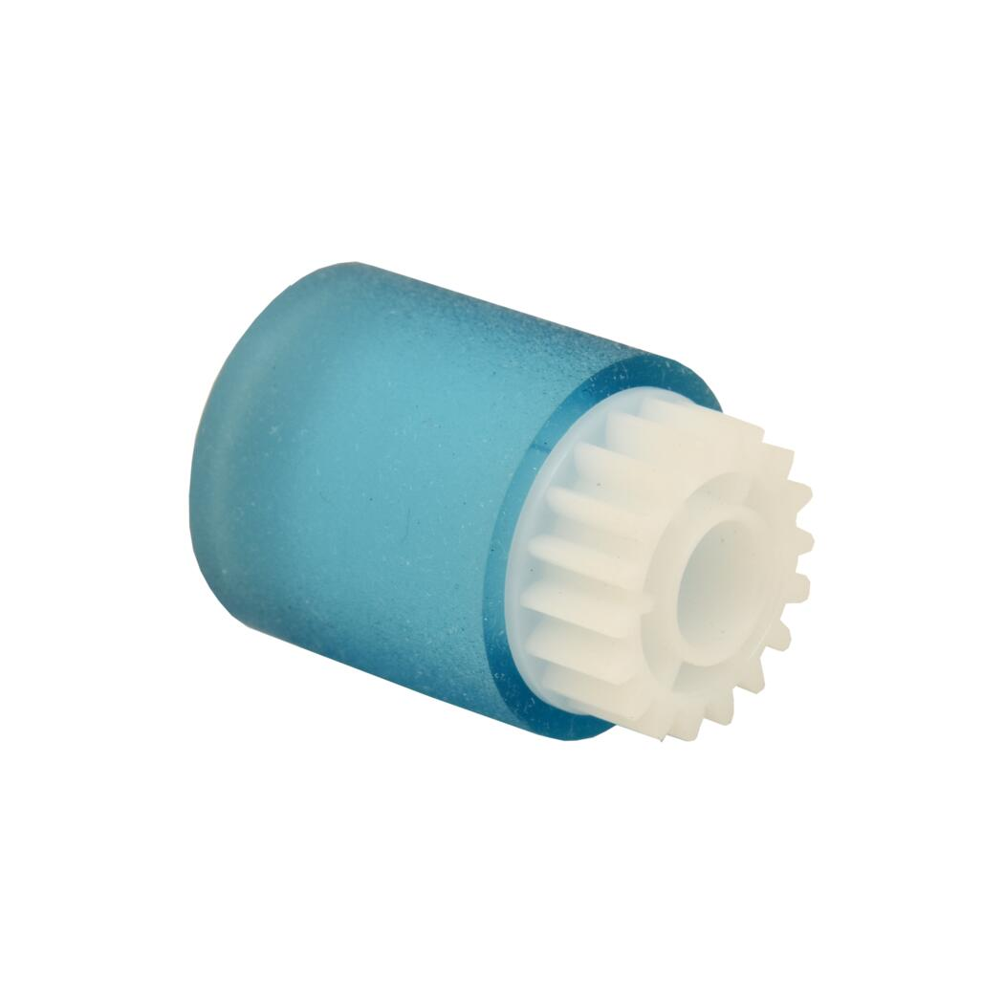
Ricoh AF03-1081 -Rollers
Criteria | Ricoh AF03-1081 | Xerox B0CNNHL559 | HP M402 | HP RF5-3340
Price | ~$25 per roller | ~$30 per roller | ~$15 per roller | ~$25 per roller
Size(mm) L x Diameter | 25.4 x 38.1 | 27.6 x 31.1 | 25.4 x 42.9 | 29.8 x 45.6
Paper Pickup Quality | Effective, reduces paper jams | Efficient feeding, reduces jams | Reliable, smooth feeding | Stable paper feeding with drive gear
Durability | High, long-lasting | Moderate, durable for heavy use | Moderate, less durable | High, stable with drive gear
Performance | Consistent, good for mixed paper types | Reliable, smooth operation, solid grip | Reliable for standard paper types | Ensures consistency under varying conditions
Grip | Solid, good for a variety of paper weights | Strong grip for smooth paper feeding | Reliable rubber material for solid grip | Strong grip, maintains paper control under varying conditions
Cost Effectiveness | Higher initial cost but long-lasting | Higher cost per roller, may not be economical long-term | Moderate price, cost-effective for regular use | Higher due to drive gear, may be unnecessary for basic applications
Replacements | Fewer replacements needed due to durability | Cost may add up for regular replacements | More frequent replacements may be needed in high-volume use | More expensive due to extra features, may need more frequent replacements if overused

Slide 24
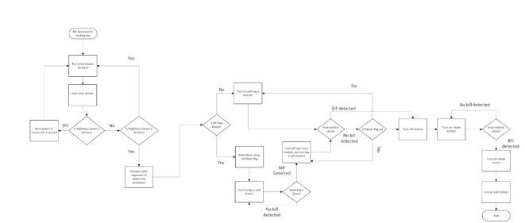
Software Block Diagram

Slide 25
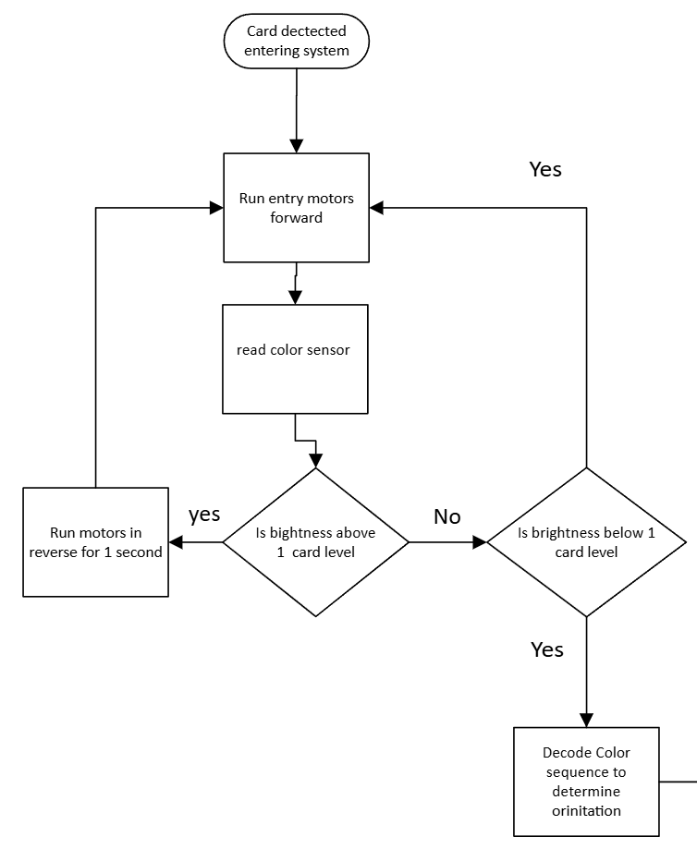
Two Card detection Flow Chart
Uses two color sensor to determine if more than card was grabbed by entry motor
One card blocks most light, two cards blocks all light

Slide 26
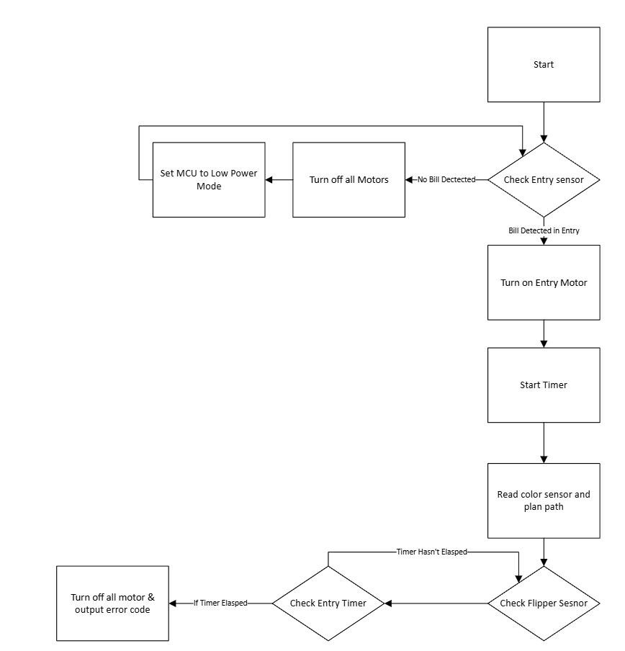
Jam Detection Flow Chart
Trip wire sensors in between each station
restart timer when card passes through trip wire sensor
If timer expires, card got stuck in station and needs assistance

Slide 27
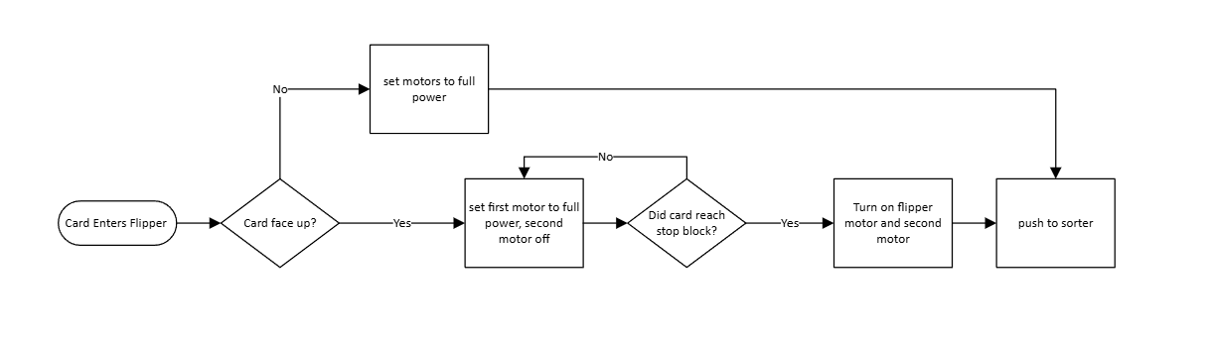
Flipper Software Flow Chart

Slide 28
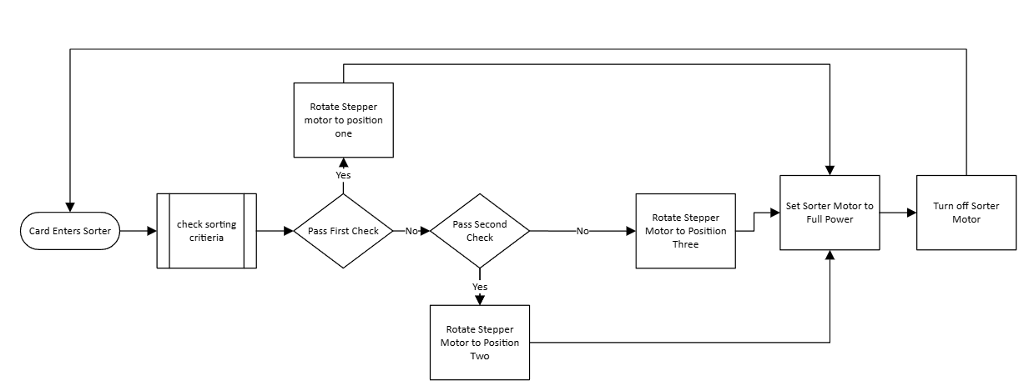
Rotator Software Flow Chart

Slide 29

Programming and Libraries Used
As we had experience in it the IDE used was the Arduino IDE
Due to the choice in IDE, we wrote the code for our project in C and Arduino Language, (Yes that is what it is called)
However fun it may have been, we did not write the code in assembly
Used some libraries to simplify the code
The Arduino ESP32 Board Package
The Adafruit library for the sensors
The DRV8912-Q1 motor library

Slide 30
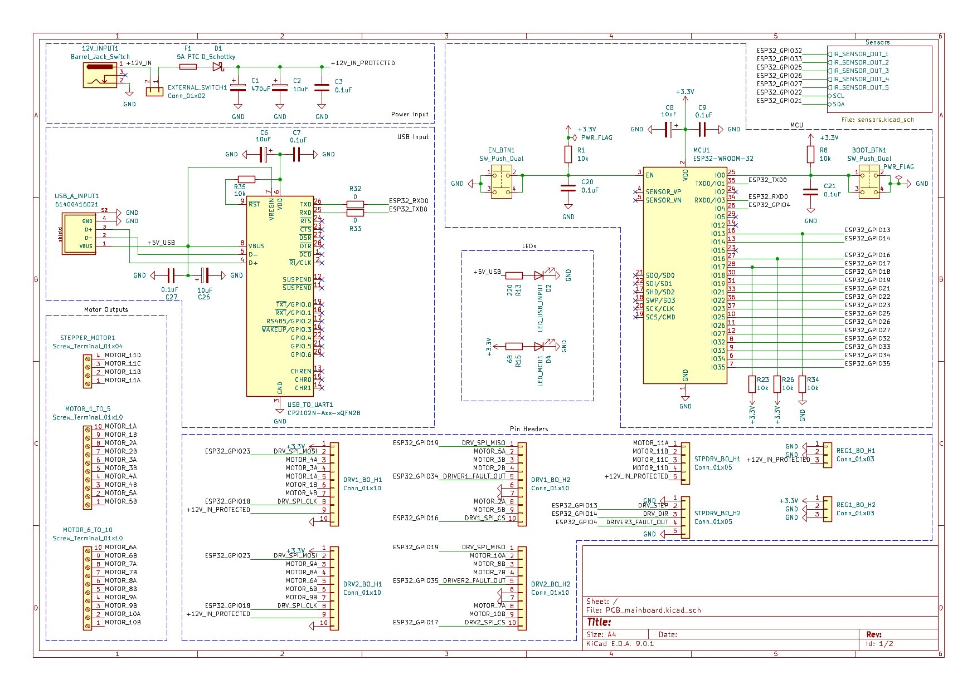
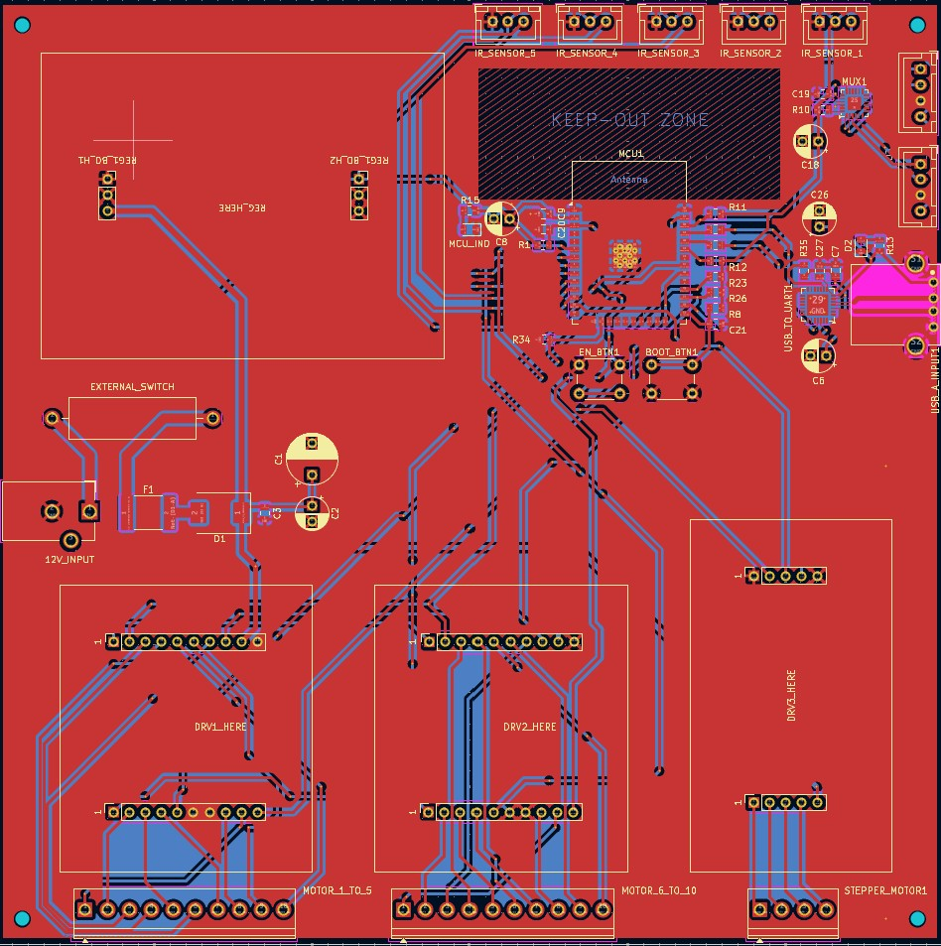
PCB - Main Board

Slide 31
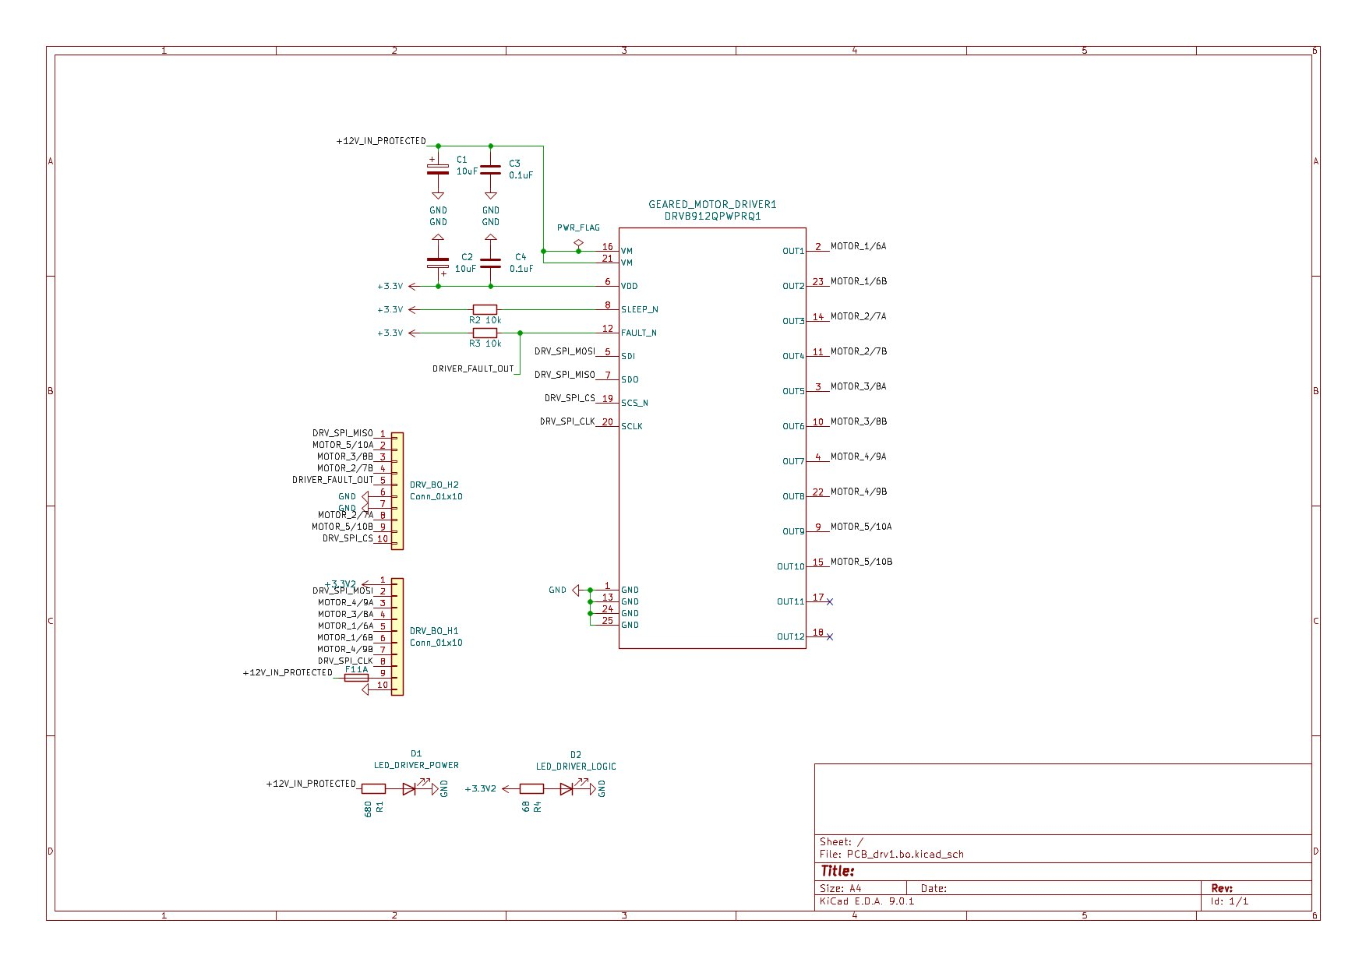
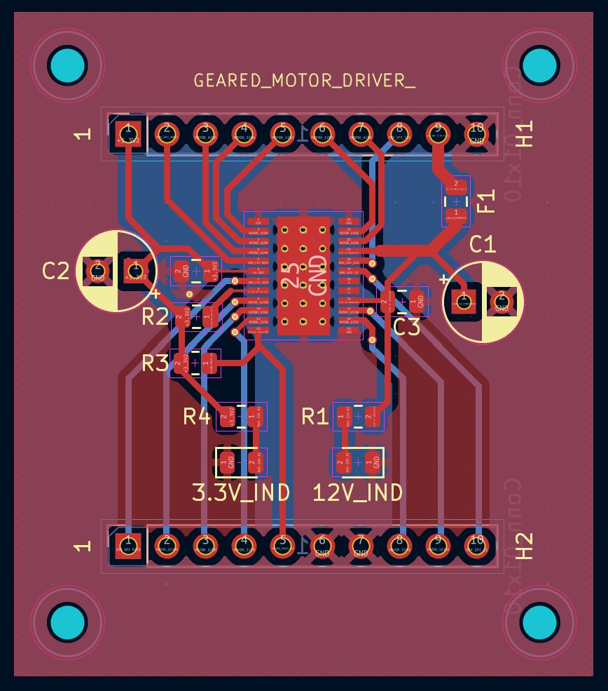
PCB - Brushed DC Motor Driver Breakout Board

Slide 32
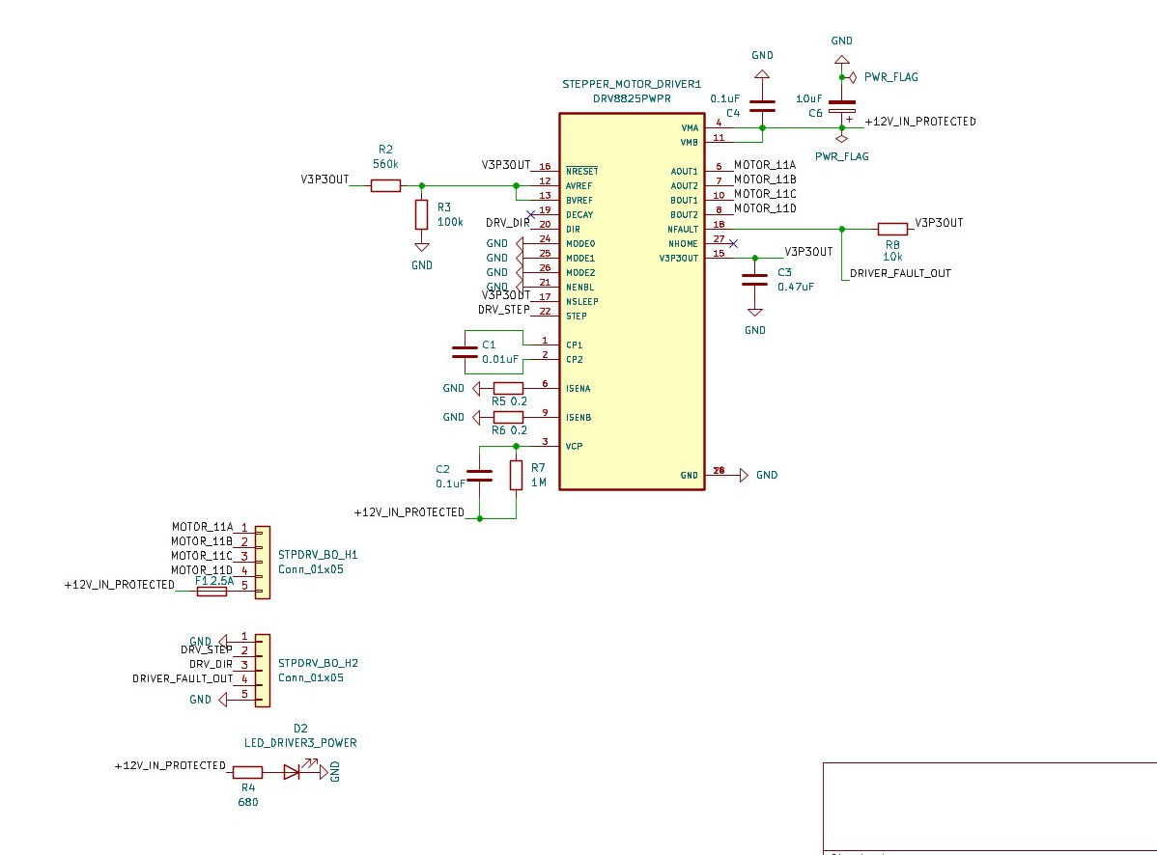
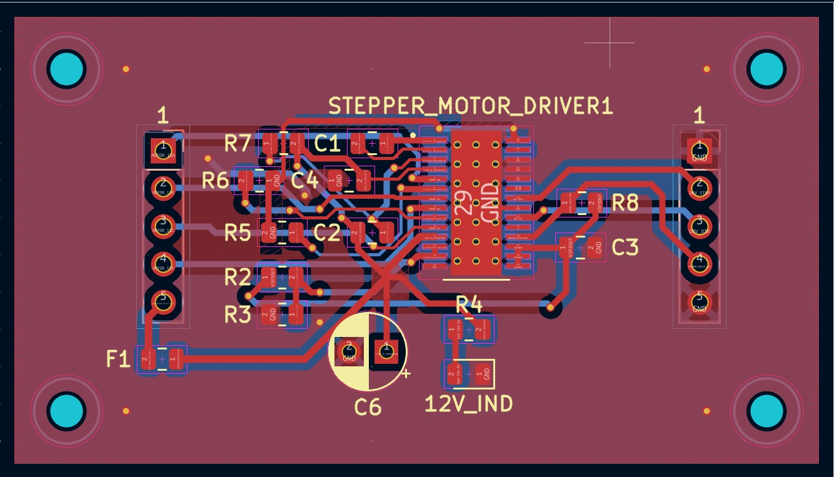
PCB - Stepper Motor Driver Breakout Board

Slide 33
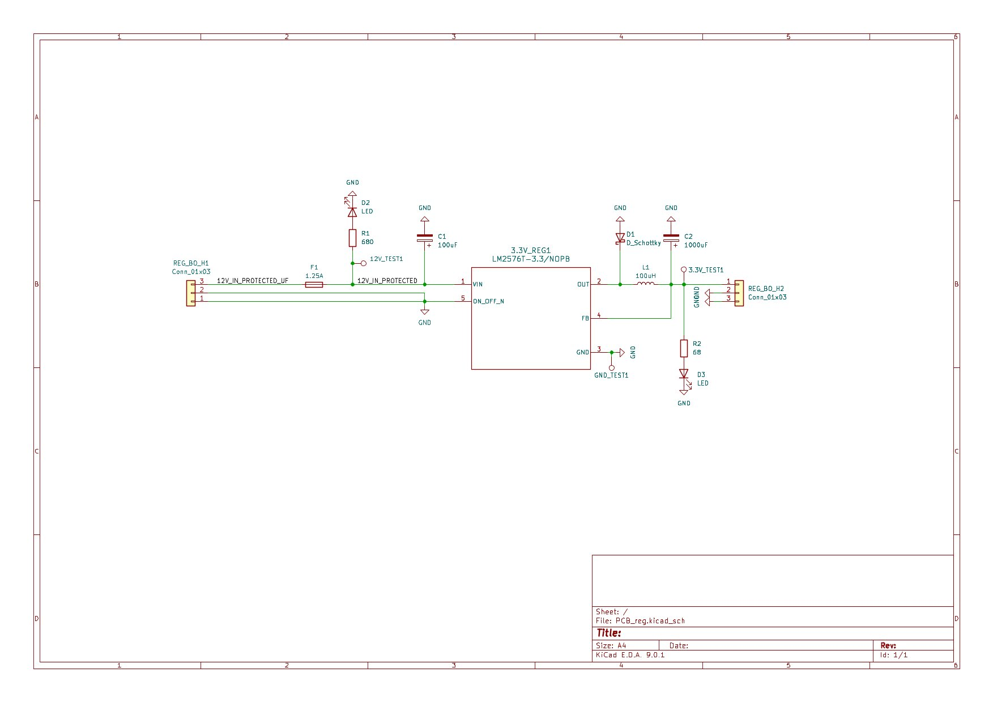
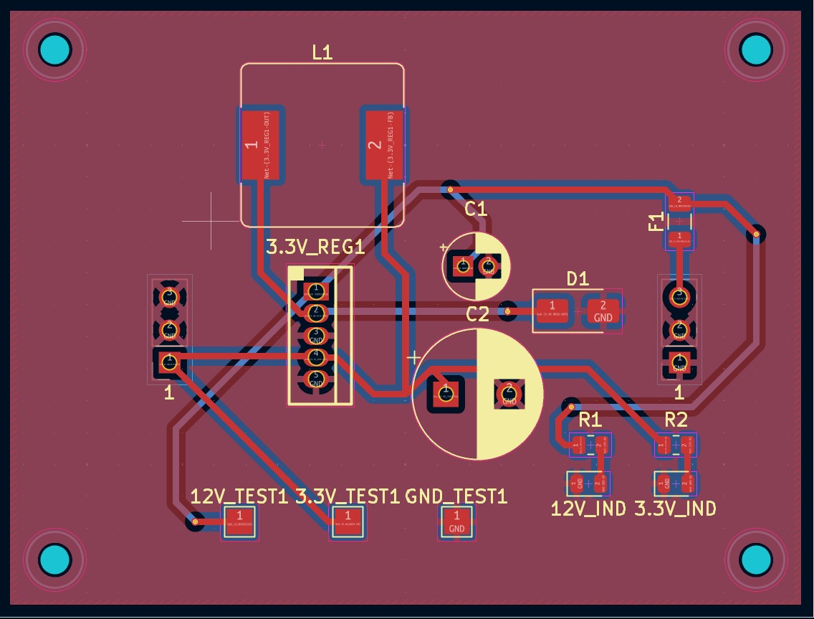
PCB - 3.3V Buck Regulator Breakout Board

Slide 34
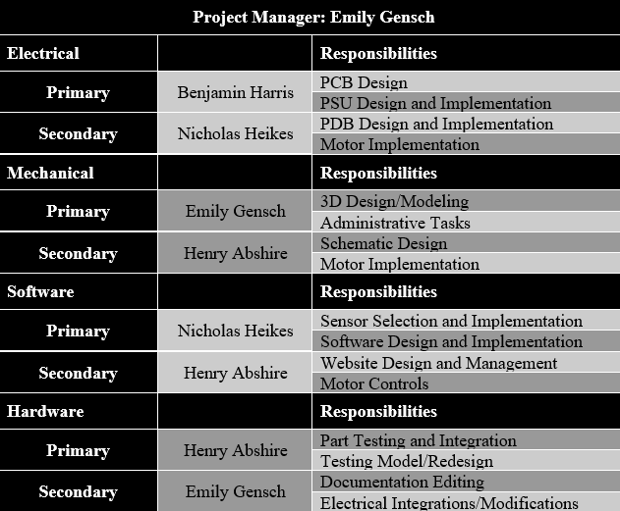
Work Distribution

Slide 35
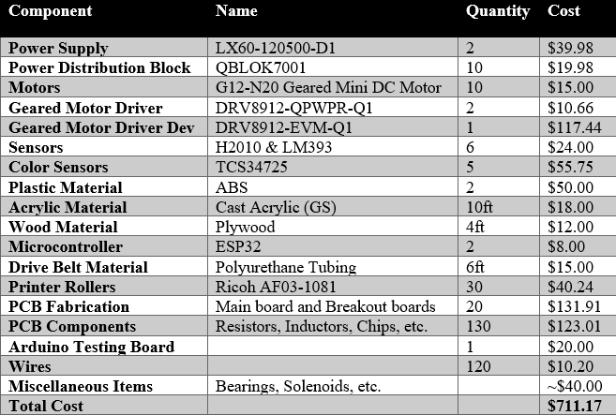
Budget Break Down

Slide 36
Component | Name | Quantity | Estimate | Cost
Power Supply | LX60-120500-D1 | 2 | 40 | $39.98
Power Distribution Block | QBLOK7001 | 10 | 20 | $19.98
Motors | G12-N20 Geared mini DC Motor | 10 | 20 | $15.00
Geared Motor Driver | DRV8912-QPWPR-Q1 | 2 | 30 | $10.66
Geared Motor Driver Dev | DRV-89-12-EVM-Q1 | 1 | 100 | $117.44
Sensors | H2010 & LM393 | 6 | 25 | $24.00
Color Sensors | TCS347 | 5 | 75 | $55.75
Plastic Material | ABS | 2 | 50 | $50.00
Acrylic Material | Cast Acrylic (GS) | 10ft | 20 | $18.00
Wood Material | Plywood | 4ft | 20 | $12.00
Micronctroller | ESP32 | 2 | 30 | $8.00
Drive Belt Material | Polyurethane Tubing | 6ft | 20 | $15.00
Printer Rollers | Ricoh AF03-1081 | 30 | 50 | $40.24
PCB Fabrication | Main board and Breakout boards | 20 | 200 | $131.91
PCB Components | Resistors, inductors, chips, etc. | 130 | 150 | $123.01
Arduino Testing Board |  | 1 | 30 | $20
Wires |  | 120 | 20 | $10.20
Miscellaneous Itmes | Bearings, solenoids, etc |  | 100 | ~$40.00
Total Cost |  |  | 1000 | $711.17

Slide 37
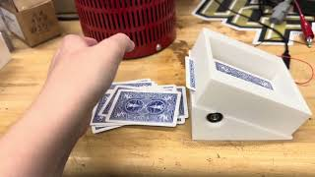
Prototyping:

Slide 38
Issues:
Card Detection Complexity: Initially, we explored using computer vision with a camera module for card orientation detection. However, our research revealed that even lightweight machine learning algorithms would require computational resources far beyond what our target microcontrollers could provide.
Mechanical Precision: Ensuring consistent card movement through the system required precise tolerances and alignment of components.
Integration Complexity: Coordinating the various sensors, motors, and mechanisms presented a significant challenge.
Budget Constraints: Working within our self-imposed budget of $450 required careful component selection and cost optimization.

Slide 39
Solutions:
Card Detection Complexity: Rather than introducing the additional complexity of external server processing, we pivoted to a more efficient approach using specific color patterns detected by the AS7341 sensor, which proved to be both reliable and computationally feasible.
Mechanical Precision: Through iterative prototyping and testing of critical elements like the custom gear shaft connectors and rollers, we achieved reliable bill handling without jams or misfeeds.
Integration Complexity: Our solution involved developing a state-based software architecture that managed transitions between different operational stages while maintaining proper timing and synchronization.
Budget Constraints: By leveraging 3D printing for custom parts and prioritizing essential components for quality while finding cost-effective alternatives for secondary elements.

Slide 40
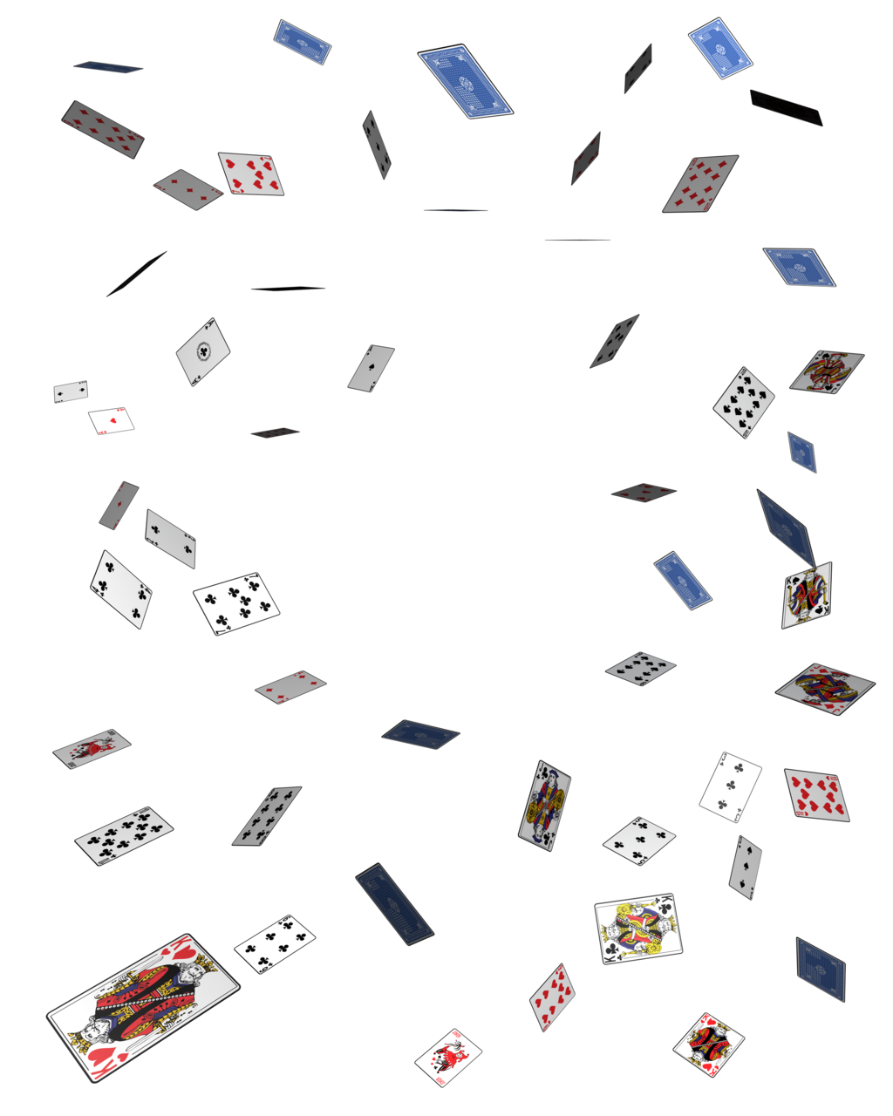
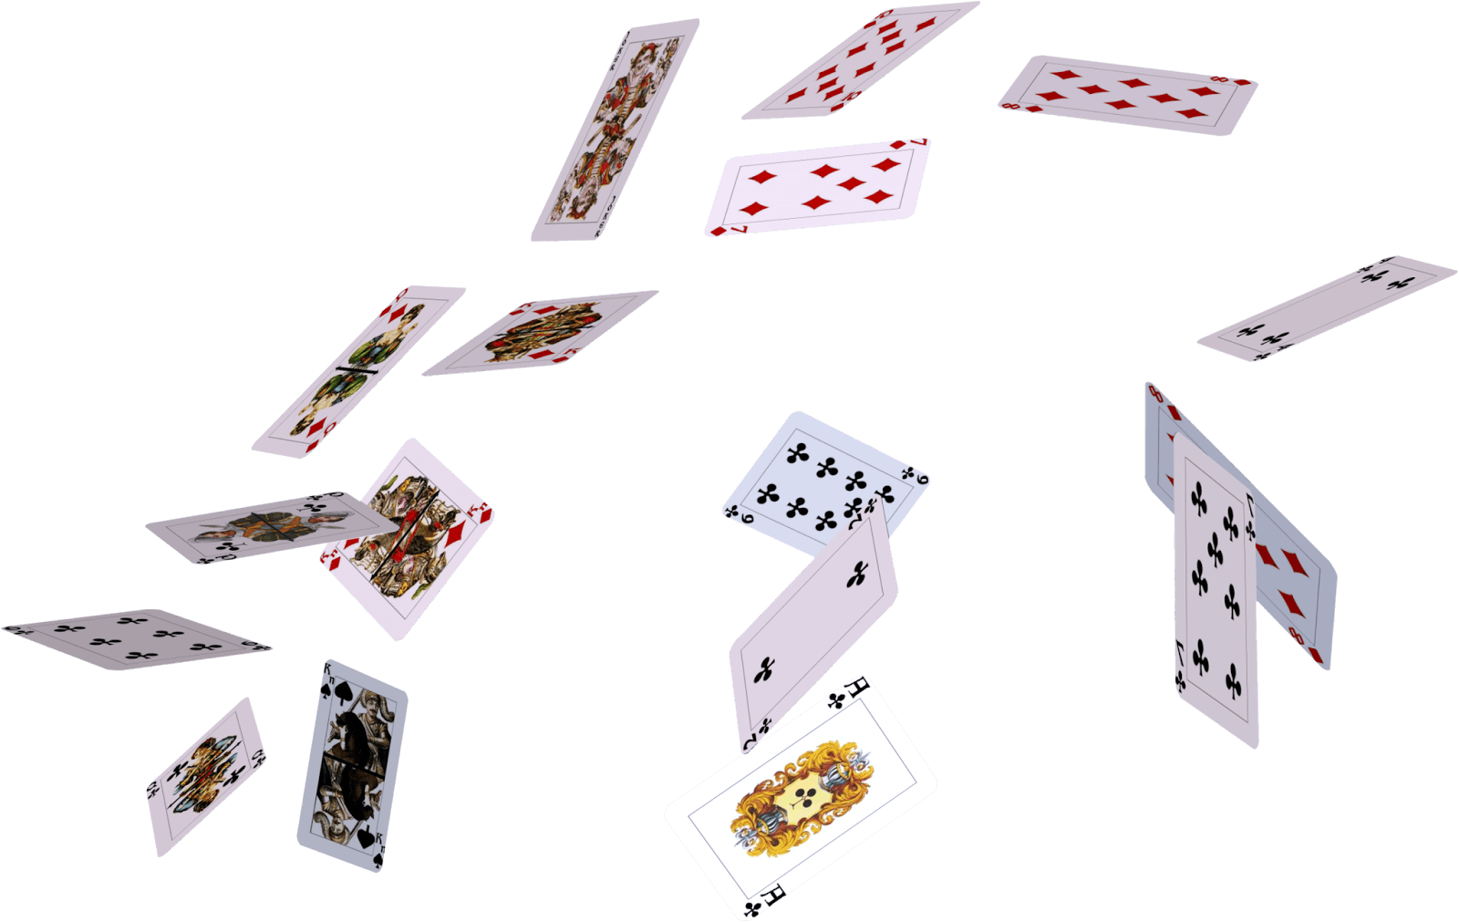
Thank you!

